Slide 1
App Store Data Challenge
By: Jason Yang
Friday, March 4th, 2022

Slide 2
Executive Summary
Opportunity in providing free app downloads to PMOF accounts
July 4th increased consumable transaction by 12.1%
Data quality: “unknown” payment type & data gap
Extra
PMOF & Free only account creations
Unsupervised account clustering

Slide 3
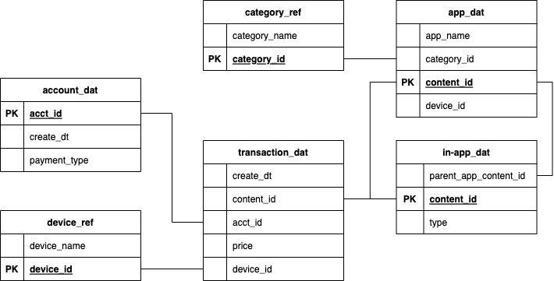
Data

Slide 4
Data
“Download”
Consumable
Subscription

Slide 5
Data

Slide 6
Data
Entertainment
Games
Photos & Videos
Social Networking
Utilities
Free only
PMOF
“unknown”

Slide 7
Question: How do Apps deliver better value to users?

Slide 8
Pay to Win
Users are paying a lot of money in Games apps
Are PMOF accounts getting good value from these transactions?

Slide 9
“Price is what you pay; Value is what you get.”
Warren Buffet

Slide 10
Free only vs PMOF Accounts
Free only accounts have much more downloads than PMOF accounts
Are Free only accounts getting good value from these transactions?

Slide 11
Free, But Not as Good?
Free accounts download at least 2x more apps than PMOF accounts
Potential bad experiences:
Lots of Ads
Unsupported App (no revenue)
Bad App

Slide 12
PMOF Account Download Time Series

Slide 13
PMOF Account Game App Downloads

Slide 14
Opportunity: Free App Downloads for PMOF
Measuring success as having more accounts downloading an app.
Lowering cost barrier to PMOF apps have the most success in delivering value

Slide 15
Takeaways
Good apps deliver great content at affordable prices
Free only apps seem to have mediocre content
PMOF apps seem to have great content with high usage cost
Recommendation
Lower or eliminate the cost barrier to PMOF apps, especially for Games category

Slide 16
July 4th Spike

Slide 17
July 4th – Only Holiday Spike

Slide 18
Increased Consumable Transactions
About 12.1% increase in transactions/account
About 1.3% decrease in price/transaction

Slide 19
Takeaways
We observed a spike in consumable transactions on July 4th.
No other spikes in other holidays
Does not appear to be due to pricing discounts
Recommendation
Inconclusive. Need to find other variables to explain the spike on July 4th

Slide 20
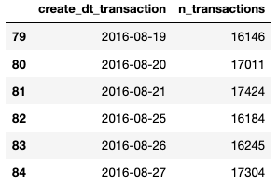
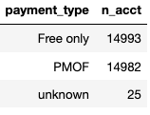
Data Quality Issues
25 acct_id’s without payment_type
data gap on 2016-08-22 to 2016-08-24

Slide 21
Next Level
I want to do a deeper analysis with more data including:
App usage metrics like crashes, duration, and rating
Better define what a “good” app
Account attributes like age, Apple subscriptions
Create account segments
Calculate Lifetime Value from subscriptions

Slide 22
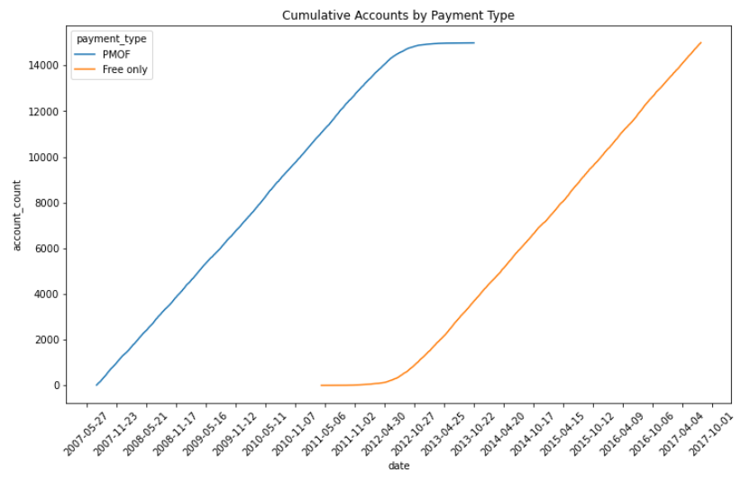
Extra: Account Creation

Slide 23
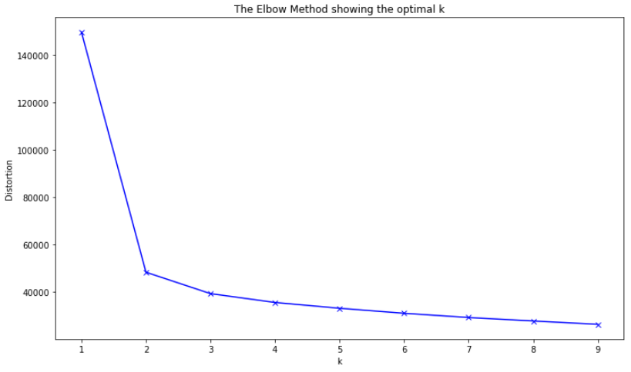
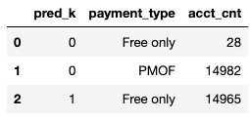
Extra: Account Clustering

Slide 24
Questions & Answers

Slide 25
Thank you

